Slide 1
NLP Project
15/08/2024
Group 2: Alex and Daan

Slide 2
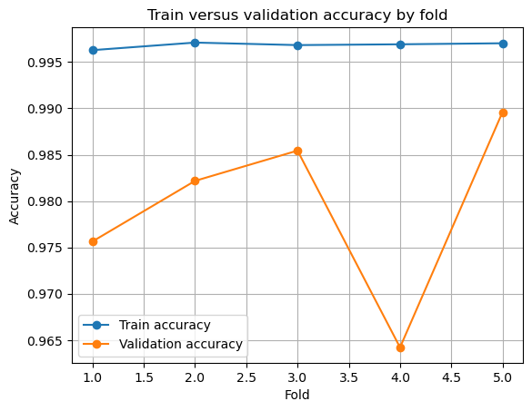
Logistic Regression (0.980 + std 0.009)
With TimeSeriesSplits
Pipeline Steps
Tokenization
Tekst cleaning / remove stopwords
Stemming and Lemmatization
Feature extraction (TF_IDF)
TimeSeriesSplits (5 folds)
Model training
Evaulation
Accuracy: 0.9864 F1 Score: 0.975
Precision: 0.996 Recall: 0.990

Slide 3
Other models
Logistic Regression (Performance: 0.980),
F1 Score 0.98, Precision 0.98, Recall 0.98
RandomForest (Performance: 0.960),
F1 Score 0.96, Precision 0.97, Recall 0.96
RandomForest w/ TSS (Performance: 0.951 std 0.032),
Accuracy: 0.9833, F1 Score: 0.927, Precision 0.998, Recall 0.982
Logistic Regression with TSS (3 folds) and Distilbert embedding (Performance: 0.926),
Accuracy: 0.8773

